Slide 1
Python = {
Въведение.py
workshop.py
[Workshop For Beginners],
{'presenter0': 'Мартин Божилов',
'presenter1‘: 'Ивайло Каньов‘}
}

Slide 2
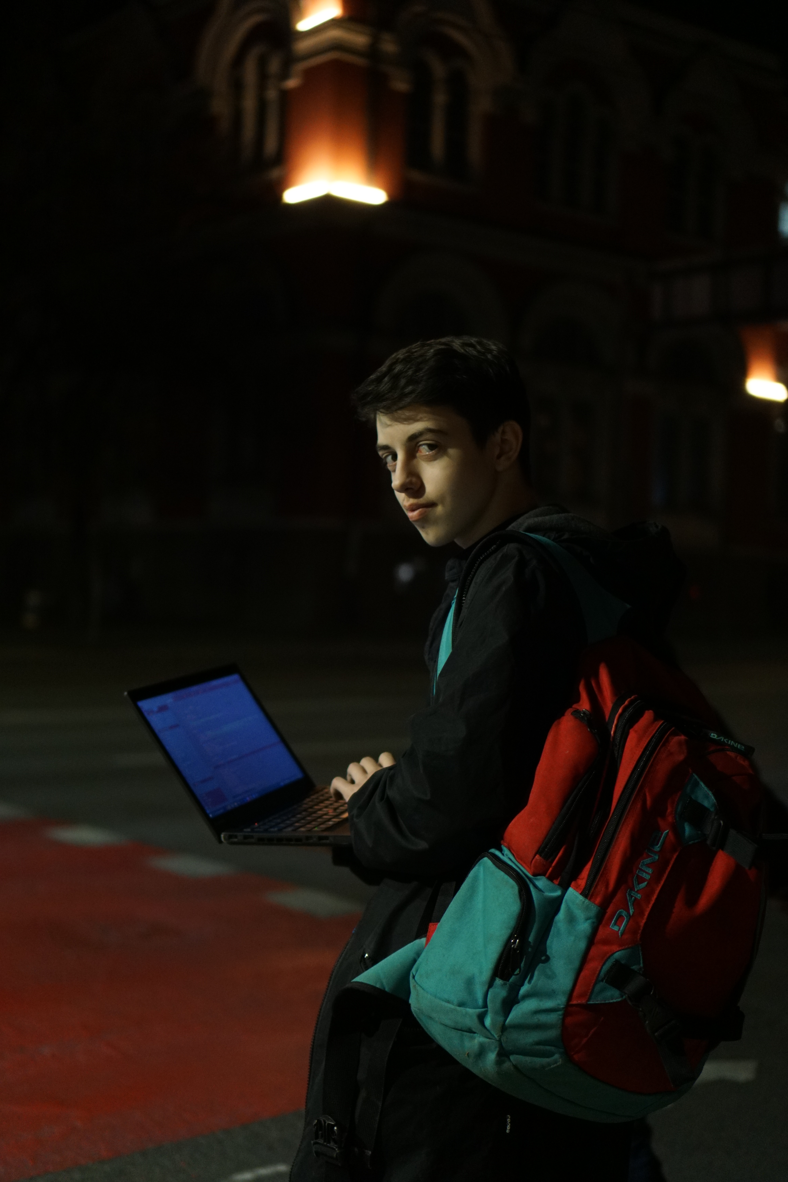

hello1.json
img1.png
{
“name” : ”Мартин Божилов”,
“age” : 17,
“grade” : 11,
“fav-programming-lang” : “Go”
}

Slide 3
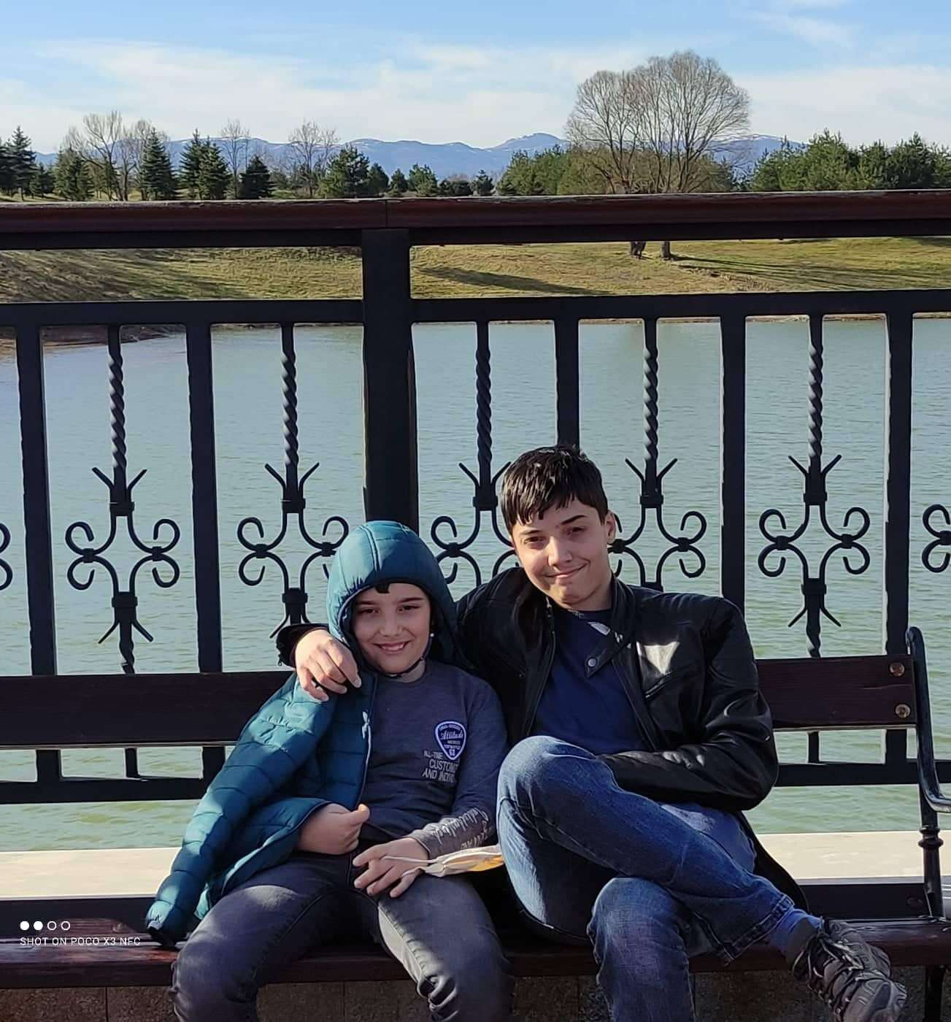
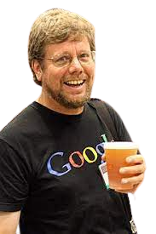
hello2.json
img2.png
{
“name” : ”Ивайло Каньов”,
“age” : 17,
“grade” : 11,
“fav-programming-langs” : [“Python”, “C#”]
}

Slide 4
TableOfContents = [
Въведение.py
workshop.py
“Machine Learning (YOLOv7)”,
“Backend Development (Flask)”,
“Frontend Development (Django)”
]

Slide 5
>>> TableOfContents[0] >>> Machine Learning (YOLOv7)
Machine Learning (ML) is a subfield of artificial intelligence (AI)
YOLOv7, short for "You Only Look Once version 7", is an ML algorithm for object detection
YOLOv7 is widely used in various applications, such as autonomous vehicles, surveillance, and robotics, due to its high accuracy and real-time performance

Slide 6

>>> TableOfContents[2] >>> Frontend Development (Django)
1. Django е известен Python web framework.
2. Следва архитектурния модел MVC
3. Набляга върху DRY метода
4. Включва много вградени функции
5. Предоставя сигурност и е надежден

Slide 7
Concepts < /1 > {
forbeginners.html
workshop.css
< Mercury is the closest planet to the Sun and the smallest one in the Solar System—it’s only a bit larger than the Moon >
}
Concepts < /2 > {
< Venus has a beautiful name and is the second planet from the Sun. It’s hot and has a poisonous atmosphere >
}
Programming Language

Slide 8
Introduction; {
forbeginners.html
workshop.css
‘Here you can give a brief description of the topic you want to talk about’
<p For example, if you want to talk about Mercury, you can say that it’s the smallest planet in the entire Solar System >
</p>
}
Programming Language

Slide 9
What Is this ‘Topic About ?’ {
forbeginners.html
workshop.css
Languages
Html
60%
Css
40%
< Mercury is the smallest planet in the entire Solar System >
< The Earth is the only one that harbors life in the Solar System >
Create a web page
Venus has a nice name
Mars is a cold place
Jupiter is a gas giant
}
Programming Language

Slide 10
Features of ‘the Topic’ {
forbeginners.html
workshop.css
Step 01
Mercury is the closest planet to the Sun and the smallest one
Step 02
Saturn is a gas giant and has several rings
Step 03
The Earth is the only planet that harbors life
Step 04
Venus has a beautiful name and is the second planet from the Sun
}
Programming Language

Slide 11
Recommendations; {
forbeginners.html
workshop.css
Mercury
< Mercury is the closest planet to the Sun and the smallest one in the Solar System >
Saturn
< It was named after the Roman god of wealth and agriculture >
Jupiter
< Jupiter is a gas giant and the biggest planet in the Solar System >
}
Programming Language

Slide 12
Examples About ‘The Topic’{
forbeginners.html
workshop.css
Mercury
Jupiter
< Mercury is the closest planet to the Sun >
< Jupiter is a gas giant and the biggest planet >
Saturn
Venus
< Saturn is a gas giant and has several rings >
< Venus has a nice name and high temperatures >
}
Programming Language

Slide 13
Practical Exercise {
< /1 >
< /2 >
forbeginners.html
workshop.css
< Saturn is the fourth-largest object by diameter in the Solar System >
Mercury is the smallest planet
The Earth is the planet we live on
Saturn is made of oxygen and helium
Jupiter is a gas giant
Venus has high temperatures
Neptune is very far away from the Sun
}
Programming Language

Slide 14
9h 55m 23s {
333,000.000
386,000 km
forbeginners.html
workshop.css
< Is Jupiter's rotation period >
< Earths fit in the Sun’s mass >
< Distance between the Moon and the Earth >
}
Programming Language

Slide 15

A ‘Picture’ Is { Worth a Thousand Words
}

Slide 16
Awesome { Words;
forbeginners.html
workshop.css
}
Programming Language

Slide 17
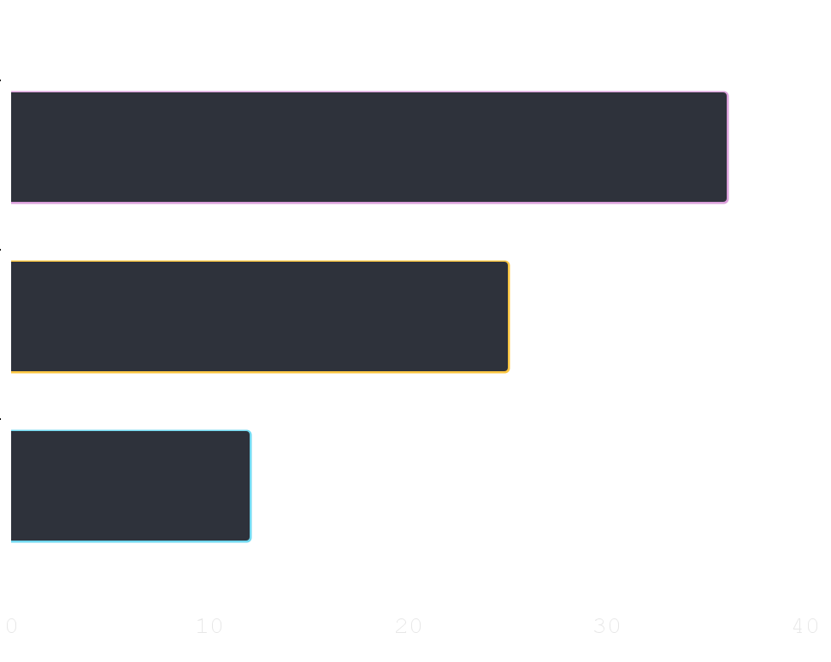
Did You Know ‘This ?’ {
forbeginners.html
workshop.css
36.00
Mercury is the smallest planet of the Solar System
25.00
Venus has a beautiful name and high temperatures
12.00
Despite being red, Mars is actually a cold place
}
Follow the link in the graph to modify its data and then paste the new one here. For more info, click here
Programming Language

Slide 18

A ‘Picture’ Always Reinforces The Concept {
forbeginners.html
workshop.css
< Images reveal large amounts of data, so remember: use an image instead of a long text. Your audience will appreciate it >
}
Programming Language

Slide 19
150,005,630 {
forbeginners.html
workshop.css
< Big numbers catch your audience’s attention >
}
Programming Language

Slide 20
— Someone ‘Famous’
forbeginners.html
workshop.css
< “This is a quote, words full of wisdom that someone important said and can make the reader get inspired.” >
Programming Language

Slide 21
Review ‘Concepts’ {
forbeginners.html
workshop.css
< Mercury is the closest planet to the Sun and the smallest one in the Solar System >
Venus
Ceres
Saturn
}
Programming Language

Slide 22
Planning of ‘September’{
forbeginners.html
workshop.css
M | T | W | T | F | S | S
 |  | 01 | 02 | 03 | 04 | 05
06 | 07 | 08 | 09 | 10 | 11 | 12
13 | 14 | 15 | 16 | 17 | 18 | 19
20 | 21 | 22 | 23 | 24 | 25 | 26
27 | 28 | 29 | 30
Mercury is the smallest planet
Venus has a beautiful name
The Earth is the third planet
Mars is actually a cold place
Jupiter is a gas giant
}
Programming Language

Slide 23
JavaScript For ‘Beginners’ {
forbeginners.html
workshop.css
Mercury
Mars
It is the closest planet to the Sun
Despite being red, Mars is a cold place
Jupiter
Venus
Jupiter is the biggest planet
Venus is the second planet from the Sun
Saturn
Neptune
Saturn is a gas giant and has several rings
Neptune is very far from the Earth
}
Programming Language

Slide 24
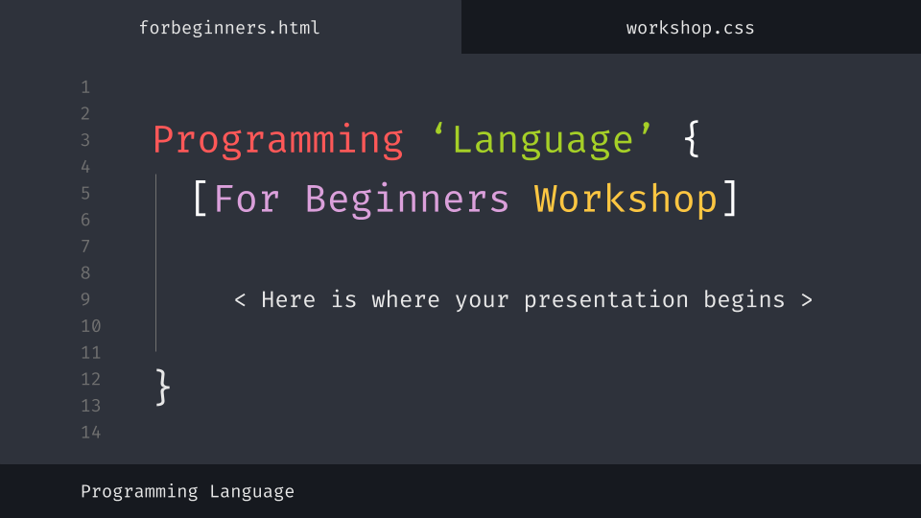
Desktop Software {
forbeginners.html
workshop.css
You can replace the image on the screen with your own work. Just delete this one, add yours and center it properly
}
Programming Language

Slide 25
Thanks; {
forbeginners.html
workshop.css
‘Do you have any questions?’
youremail@freepik.com
+91 620 421 838
yourcompany.com
< Please keep this slide for attribution >
}
Programming Language

Slide 26
Web ‘Design’
forbeginners.html
workshop.css
Programming Language

Slide 27
Alternative ‘Resources’ {
forbeginners.html
workshop.css
Here’s an assortment of alternative resources whose style fits the one of this template
Photos:
Portrait hacker I
Portrait hacker II
}
Programming Language

Slide 28
Resources {
forbeginners.html
workshop.css
Did you like the resources on this template? Get them for free at our other websites:
Photos:
Close up hacker
Medium shot woman working computer
Icons:
Web design
}
Programming Language

